Slide 1
Spatial simulation experiment for TOA NIWA team (CASAL)
Arnaud Grüss, Jeremy McKenzie, Simon Hoyle, Sophie Mormede, Jennifer Devine
Monday 6 March 2023

Slide 2
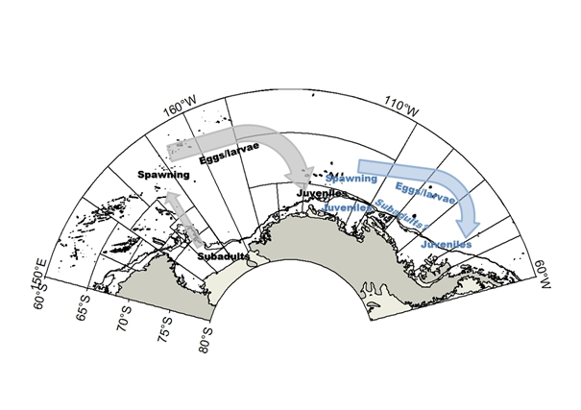

Ross Sea region Antarctic toothfish (TOA) (1 / 2)
Antarctic toothfish (Dissostichus mawsoni; TOA): Economically-important large-bodied species of family Nototheniidae, endemic to Antarctic and sub-Antarctic waters
Key ecological feature: Ontogenetic spatial distribution patterns (Hanchet et al., 2008):
Juveniles and young adults recruit to the Ross Sea region (RSR) shelf (i.e., at depths less than 800 m)
Antarctic toothfish undertake ontogenetic migrations, i.e., move into deeper waters as they grow older
Spawning takes place in the north, on seamounts, ridges and banks, in winter likely between mid-July and August (Hanchet et al., 2010; Parker et al., 2019)
The eggs and larvae of Antarctic toothfish are then transported by the Ross Sea gyre to the RSR shelf
RSR Antarctic toothfish is considered an enclosed unit stock centred on the Ross Sea gyre, based on stock structure analyses (Parker et al., 2014)
Hypothesized biological structure for Antarctic toothfish stocks in the Ross Sea region (black text and grey arrows) and Amundsen Sea region (blue text and arrows). Eggs/larvae (<30 cm), juveniles (30–80 cm), subadults (80–120 cm), spawning (>120 cm). Italics indicate uncertain distribution (Fig. 10 from Parker et al., 2014)

Slide 3
Ross Sea region Antarctic toothfish (TOA) (2 / 2)
Bottom longline is the only fishery that has operated in RSR since 1997
Fishing takes place in summer. Starts on the 1st December each year in the north, progresses south as sea ice retreats, and stops when the catch limit is reached (typically in January–February; Grüss et al., 2021a)
Important event in RSR was the establishment of the Ross Sea region Marine Protected Area (“RSrMPA”), adopted in 2016 and came into effect in the 2018 fishing season (CCAMLR-XXXVI, 2017) – This resulted in a re-definition of management areas in the RSR (see the map here)
Management areas in the RSR:
General Protection Zones (GPZ) (i)–(iii), where fishing is not permitted
Special Research Zone (SRZ), where fishing is permitted at a low exploitation rate
N70 (North of 70° S) management area
S70 (South of 70° S) management area
Also note:
Krill Research Zone (KRZ), part of RSrMPA, but there has never been any commercial longlining there
Depth contour plotted at 800 m

Slide 4
Data from the operating model (OM) for TOA
OM provided spatially-explicit data – not all of the data were used in the stock assessment models:
(1) Total catches in biomass, for each year of the period 1998–2021- USED in the stock assessment models
(2) Catches-per-unit-effort (CPUEs) in kg per 1000 hook, for each year of the period 1998–2021 – UNUSED
(3) Proportions-at-age of the catch, for each year of the period 2002–2020 – USED
(4) Proportions spawning for each length class in the catch, for each year of the period 2002–2020 – UNUSED
(5) Proportions-at-age of tagged and released fish, for each year of the period 2001–2020 – USED
(6) Proportions-at-age of fish recaptured with a tag, for each year of the period 2002–2020 – USED
Unused in the stock assessment model, because …
(2) Unused because never used in RSR Antarctic toothfish assessments - Changes in TOA CPUE are not consistent with likely “fish down” changes in TOA abundance and appear to partially reflect spatial management boundary changes, ice-driven availability on an annual basis, and continuing improvement in skill and fishing strategy by the fishing fleet rather than underlying abundance (Grüss et al., 2021c)
(4) Unused because never used in RSR Antarctic toothfish assessments (Grüss et al., 2021b)

Slide 5
Stock assessment models (1 / 4)
Implemented using the CASAL software package (Bull et al., 2012)
Standard assessment modelling platform in New Zealand, which was chosen because it:
(1) Has spatial capabilities:
(i) Areas-as-fleets models (like the models presented in the following)
(ii) Spatially-explicit models, with migrations between regions
Most spatially-explicit stock assessments in New Zealand assume natal fidelity, i.e., fish spawned from a given stock will return to their natal spawning ground
(2) Can account for tag releases and recaptures by age or length
We started by reading relevant reports and papers on TOA and its fishery to determine how the stock assessment models should ideally be structured and which assumptions they should make
Then we developed a one-area model, gradually increasing its complexity and checking fits and residuals until we reached a final model structure
Developing a four-area model was then relatively straightforward with the “areas-as-fleets” approach as, basically, all that we needed to do then was specifying catches and catches-at-age for four fleets instead of one single fleet
The four fleets correspond to the four management areas that were considered in the OM to generate pseudo-observations for the modelling exercises: GPZ, SRZ, N70 and S70

Slide 6
Stock assessment models (2 / 4)
Our one-area and four-area models are for one single region
Our four-area models account for some spatial structure by estimating separate fishing selectivities for the different management areas of the RSR, using the “areas-as-fleets” approach (Punt, 2019)
Areas-as-fleets approach used in the actual TOA assessment
Selectivity-at-age clearly varies among management areas given TOA ontogenetic spatial distribution patterns
Unsexed models, while the RSR Antarctic toothfish assessment model is a sexed model – because the OM provided only unsexed data
Age structured models considering ages 2 to 30+ – because the OM provided data for those specific age classes
Follow tag cohorts through time, specifically 20 tag cohorts that correspond to tag releases in years 2001 to 2020
Represent dynamics in years 1995 to 2021
Divide each year into three time steps, including summer (November-April), winter (May-October), and an age-incrementation time step – because of TOA ecology and fishery specifics described earlier
In Time-step 1, recruitment takes place, then tag releases and tag recaptures
Next, half of the natural mortality is applied (in Time-step 1), then instantaneous fishing mortality (in Time-step 1), then half of the natural mortality (in Time-step 2)
Spawning takes place at the end of Time-step 2
Spawning stock biomass (SSB) is recorded after half of the natural mortality has been applied in Time-step 2

Slide 7
Stock assessment models (3 / 4)
The models include the following areas-as-fleets:
One-area model: RSR (Ross Sea region)
Four-area model: N70, S70, SRZ (Special Research Zone), and GPZ (General Protection Zones)
For each fleet:
Selectivity-at-age is assumed to follow a capped double-normal distribution, and the parameters of the selectivity-at-age functions are estimated
Selectivity-at-age parameters of the one-area model estimated using same priors as main fleet of the four-area model (S70)
Annual catches are defined, a maximum fishing pressure of 0.999 is assumed, catch limit penalties are implemented (note that fish tagged penalties are also implemented)
Proportions-at-age and input sample sizes are provided
Multinomial distribution used, input sample sizes reweighted using Francis (2011)’s TA1.8 method
Tag releases and recaptures: Critical to estimate population size over time as we do not use CPUEs
For each year of 2001-2020, total number of tag releases and proportions tagged at age are provided
For each year of 2002-2020, proportions scanned at age and proportions recaptured at age are specified
In-year recaptures are ignored, only the tags that have been at liberty for a maximum of 6 years are considered – as in the actual TOA assessment
A quasi-Binomial distribution was used for the tag-recapture data, and the dispersion term for the tag-recapture likelihood was initially set to 1.0 and was reweighted using the “Reweight.tags” function from R package “DataWeighting” (Francis, 2015) – Here we are downweighing the influence of proportions-at-age relative to that of tagging data, hence following good practices in fisheries science (Francis, 2011)

Slide 8
Stock assessment models (4 / 4)
Recruitment process:
Fish recruit at age 2 (https://aaronmberger-nwfsc.github.io/Spatial-Assessment-Modeling-Workshop/articles/OM_Description_TOA.html )
Recruitment is given by mean (unfished) recruitment (R0) multiplied by the Beverton-Holt spawning stock-recruitment relationship, where R0 is estimated
Steepness parameter set to 0.75 (https://aaronmberger-nwfsc.github.io/Spatial-Assessment-Modeling-Workshop/articles/OM_Description_TOA.html)
Year class strengths (YCS’s) in 1993-2019 are estimated
Maturation process:
Applied in Time-step 2; and maturation is specified as the time-invariant proportion of fish at age that are mature, using a logistic function and the parameters from Parker and Marriott (2012)
Natural mortality and growth and length-weight parameters all taken from https://aaronmberger-nwfsc.github.io/Spatial-Assessment-Modeling-Workshop/articles/OM_Description_TOA.html
Natural mortality fixed at a single value for the sake of simplicity

Slide 9
Results of Objective 1 (1 / 9)
Workshop Objective 1 addressed with Replicate #2
One-area and four-area CASAL models run both in the Maximum Posterior Density (MPD) and Markov Chain Monte Carlo (MCMC) modes
Diagnostics examined – Not shown in this presentation because of time limitation:
Pearson residuals of the proportions-at-age, expected and observed proportions-at-age for the different fleets, bubble plots of the Pearson age residuals
Boxplots of the observed age frequencies in the different fleets shown together with maximum MPD fits, trend in the 90th percentile of the observed age frequency in the different fleets shown together with MPD fit
Observed versus expected number of tags recaptured by tag recapture year for each tag release year
Observed versus expected number of tags recaptured by tag recapture year for each tag release year
Observed versus expected median ages of tag recaptures for each tag release year
Expected minus observed number of tagged fish recaptured each year per year of release
Pearson tag recapture residuals
MCMC posterior trace plots, MCMC diagnostics
MCMC predicted median ages vs. and observed median ages in the catch in the different fleets

Slide 10
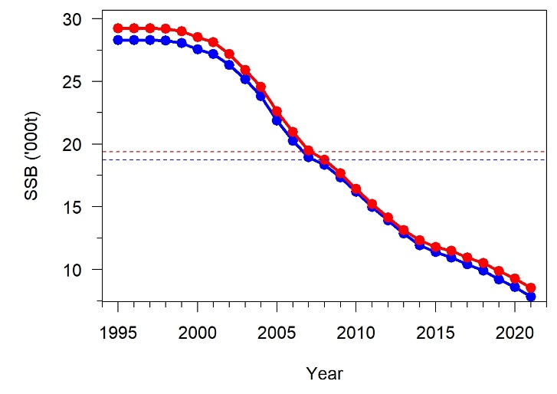
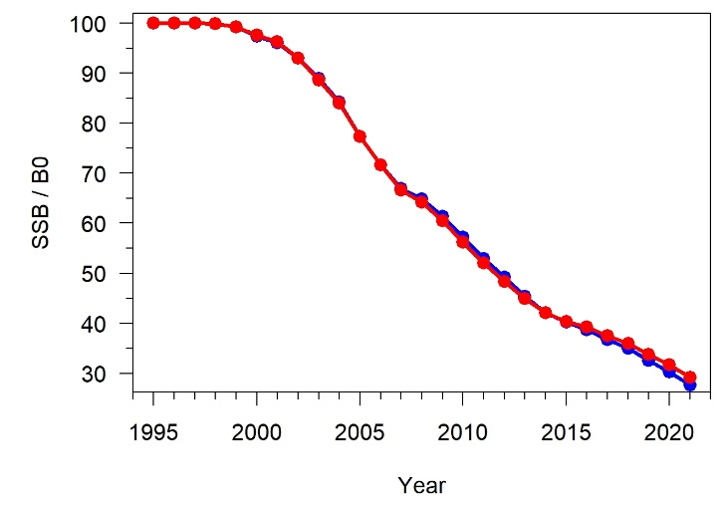
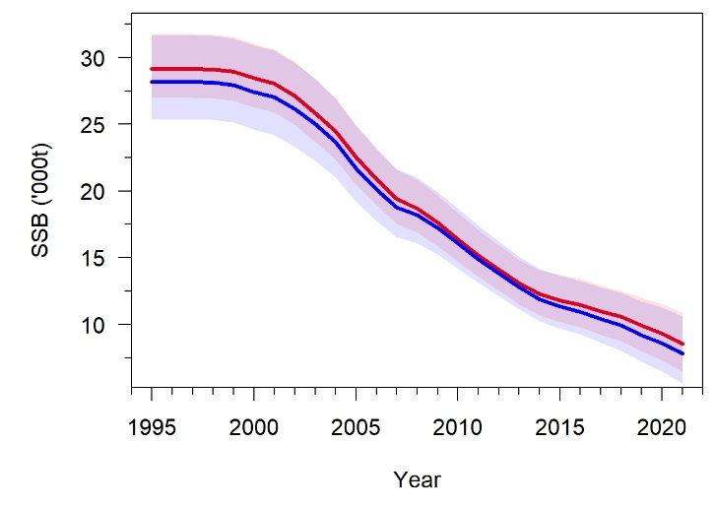
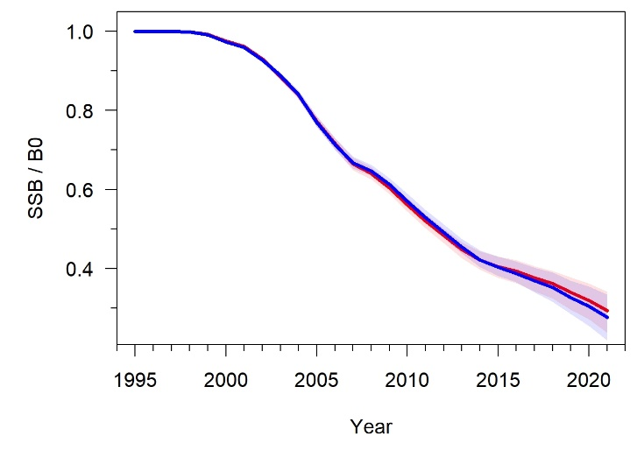
Results of Objective 1 (2 / 9)
SSBs, Initial SSB (B0), initial recruitment (R0), current SSB (B2021), and current stock status (B2021 over B0) are all slightly higher for the four-area model than for the one-area model
MPD results
MPD results
 | Four-area model | One-area model
B0 (t) | 29 223 | 28 287
R0 (number of fish) | 522 015 | 505 293
B2021 (t) | 8539 | 7817
B2021 / B0 | 0.292 | 0.276
MCMC results

Slide 11
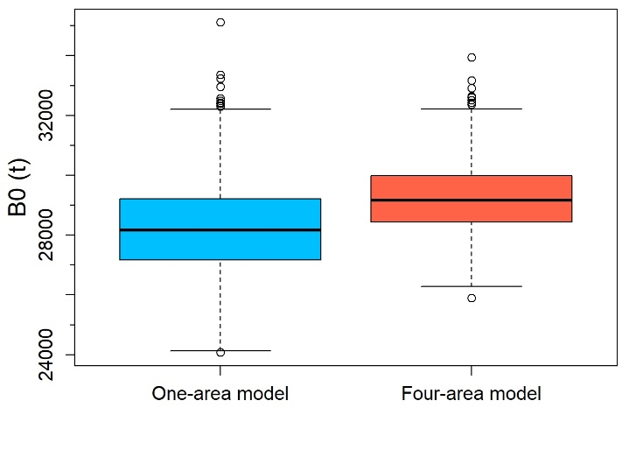
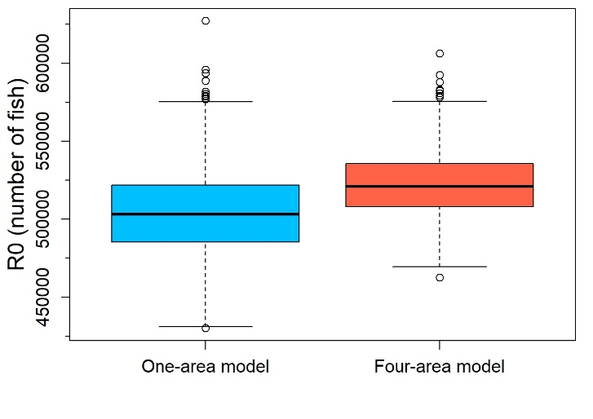
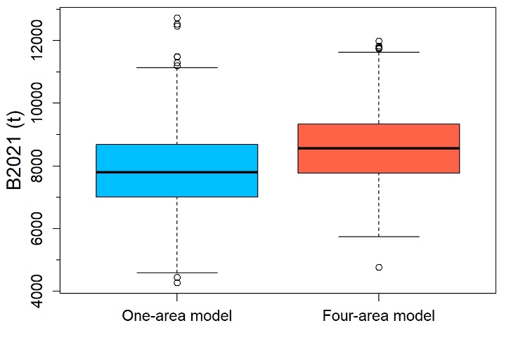
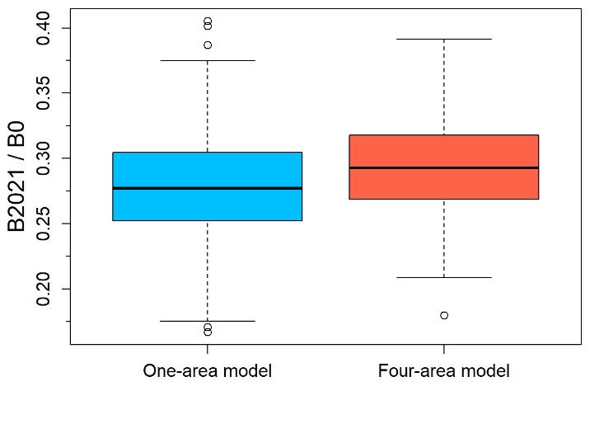
Results of Objective 1 (3 / 9)
Looking at MCMC results, we can observe that B0, R0, B2021 and current stock status (B2021 over B0) are all slightly higher for the four-area model than for the one-area model, but are also less uncertain for the four-area model
(Although one can interpret that the four-area and one-area models estimated a similar current stock status (B2021 over B0) for TOA )

Slide 12
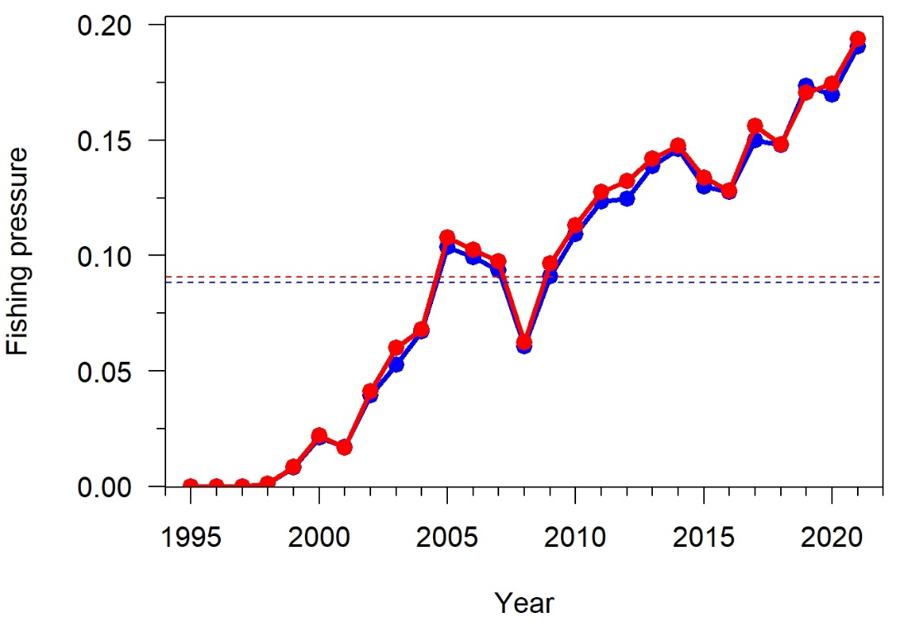
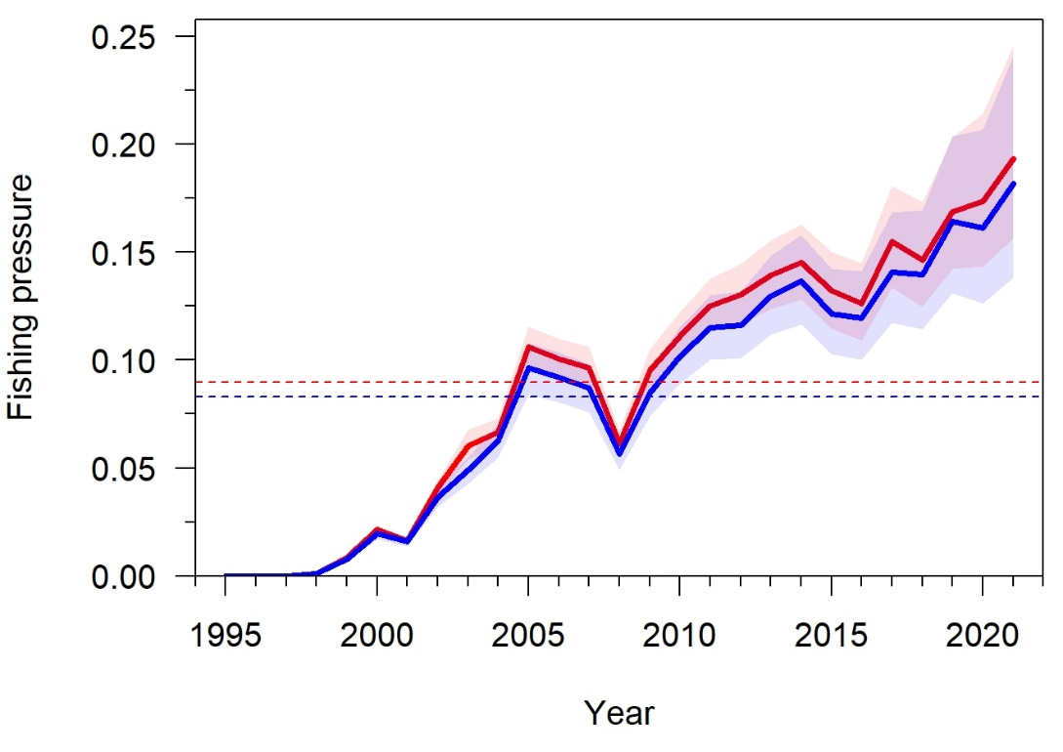
Results of Objective 1 (4 / 9)
The four-area model usually estimated slightly higher annual fishing pressures than the one-area model
MPD results
MCMC results

Slide 13
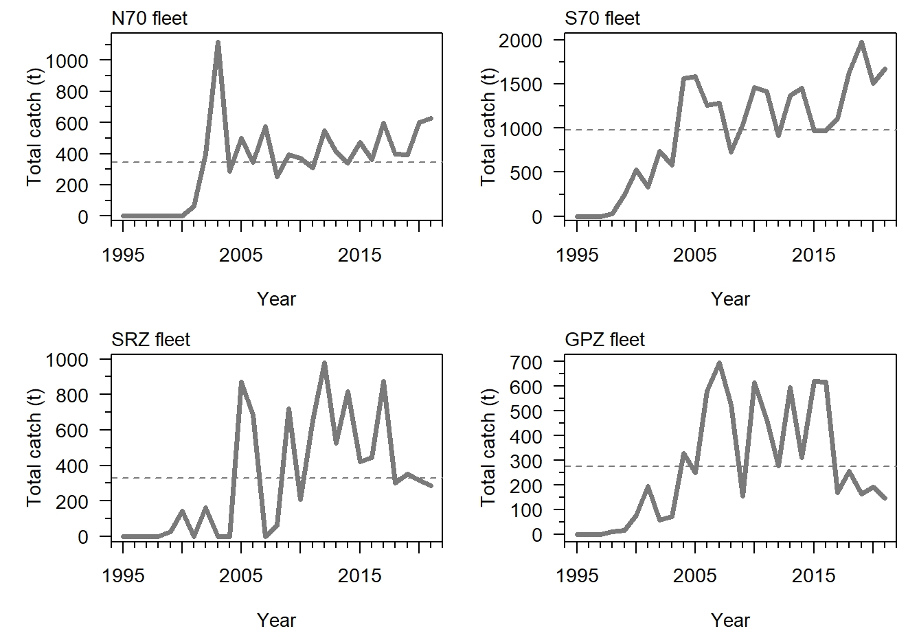
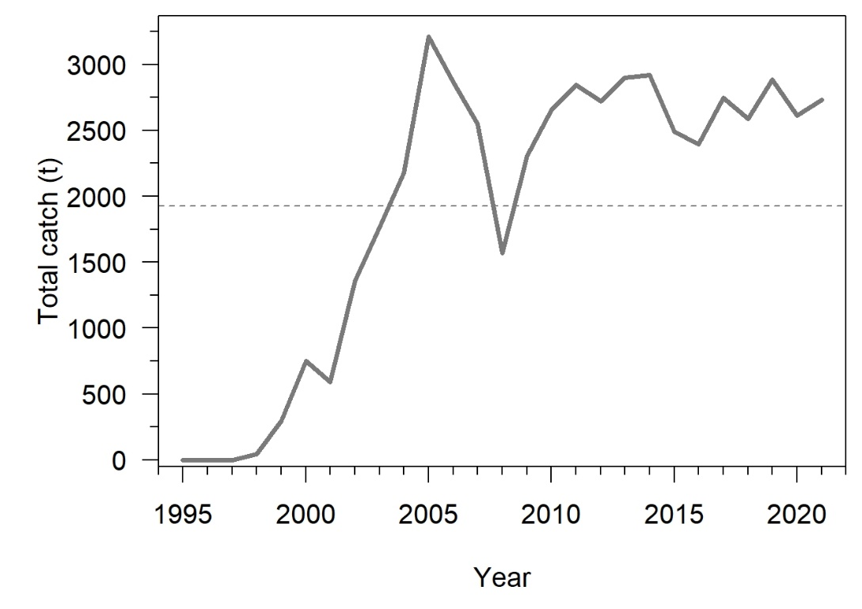
Results of Objective 1 (5 / 9)
The trends in total catch for the RSR fleet (one-area model) are similar to the trends in total catch for the S70 fleet (main fleet in the four-area model): Increase between 1997 and 2021 that reflects the tendency for fishing effort to have concentrated on the RSR Slope since the inception of the longline fishery
In recent years, the slight increase in total catch for the N70 fleet mirrors the decrease in total catch for the GPZ and SRZ fleets
Four-area model
One-area model

Slide 14
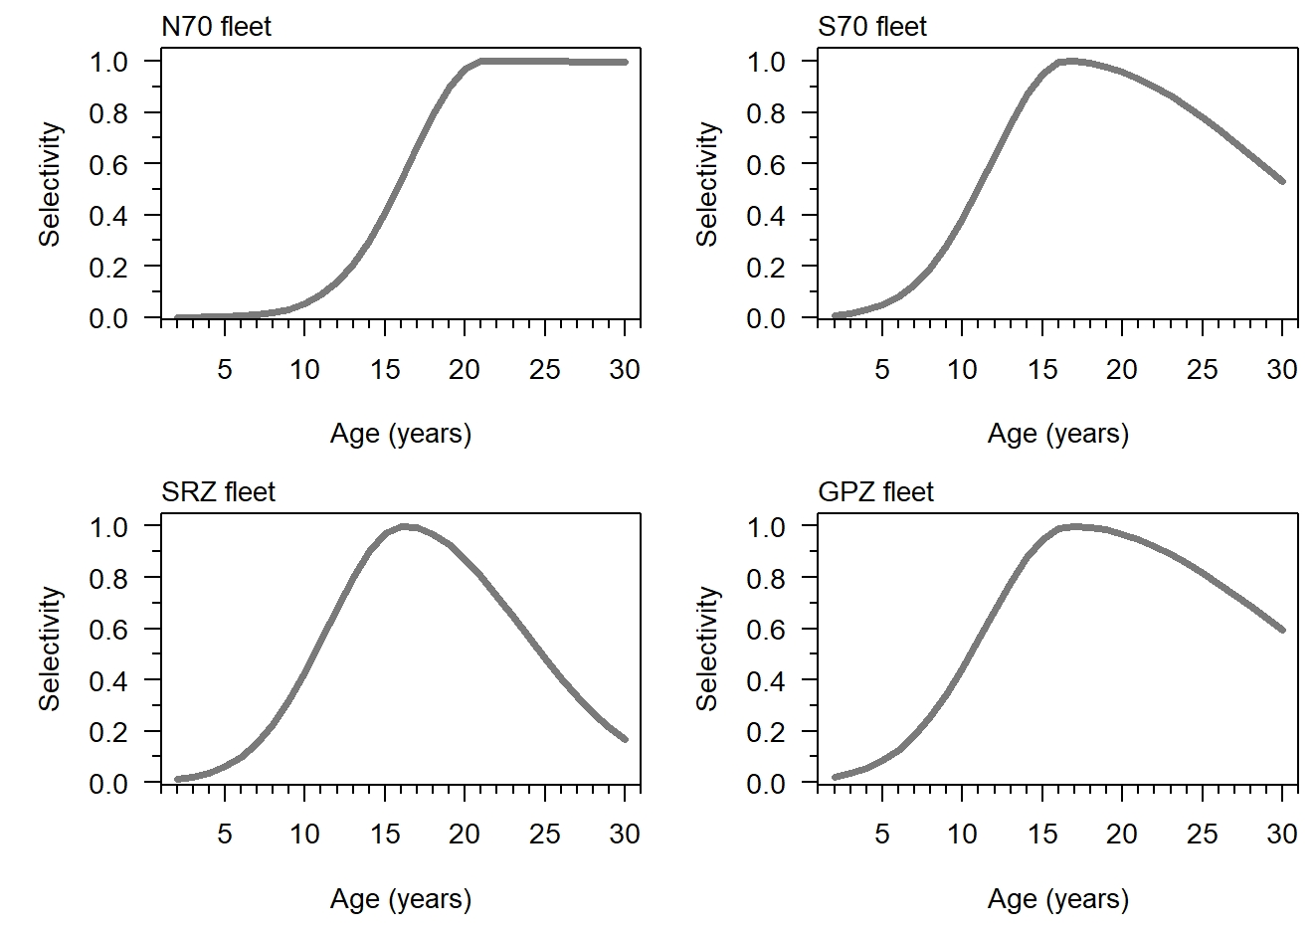
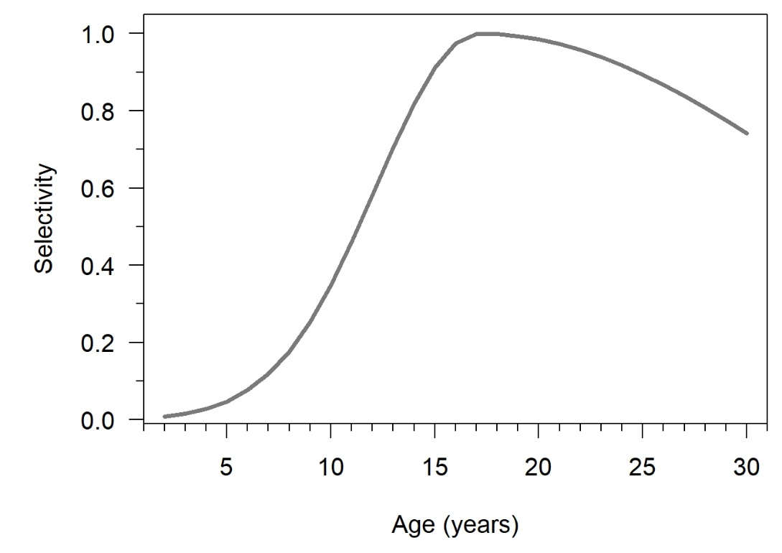
Results of Objective 1 (6 / 9)
Estimated selectivity function for the RSR fleet (one-area model) similar to estimated selectivity function for the S70 fleet (main fleet in the four-area model): dome-shaped, as for the SRZ and GPZ fleets
Estimated selectivity function the N70 fleet is different: Flat-topped, i.e., the oldest TOA individuals, which are found in the north of the RSR, are fully selected
MPD results for the four-area model
MPD results for the one-area model

Slide 15
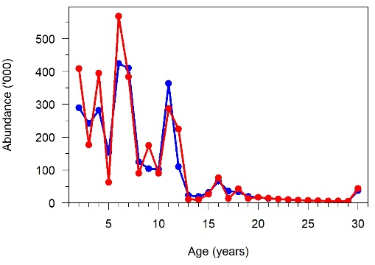
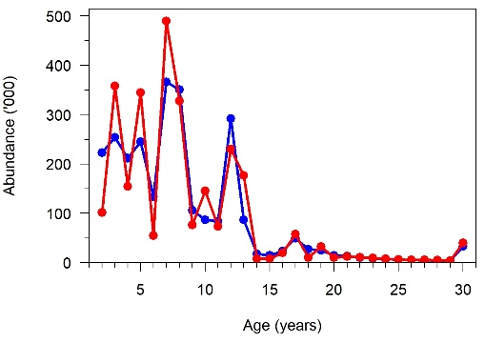
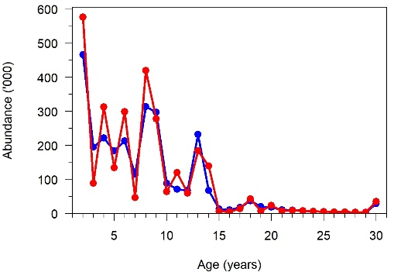
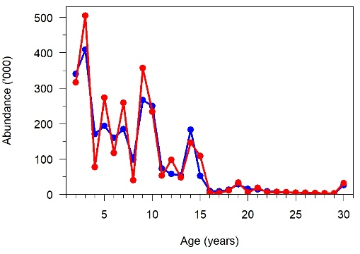
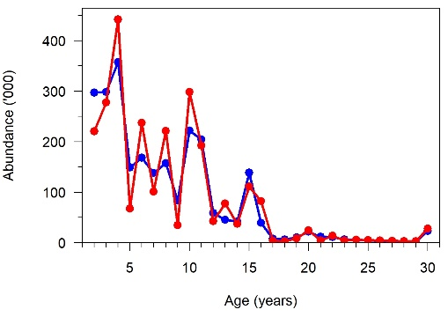
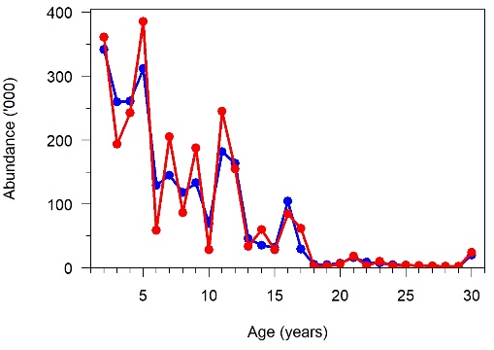
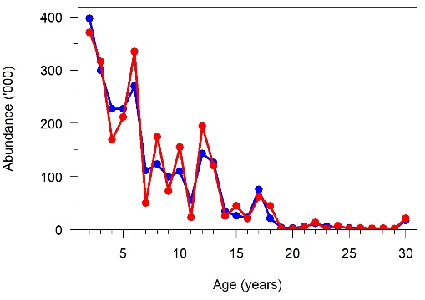
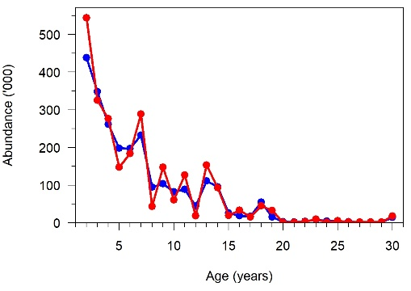
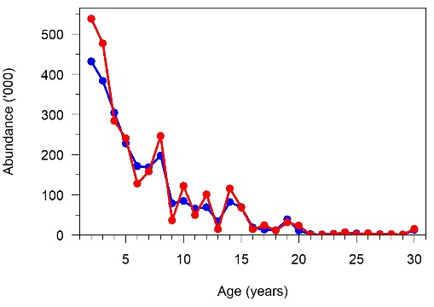
Results of Objective 1 (7 / 9)
Looking at MPD results, we can note differences in abundances-at-age between the four-area and the one-area models, especially more variability in age structure for the younger ages (< 15-year-old) in the four-area model
2013
2014
2015
2016
2017
2018
2019
2020
2021

Slide 16
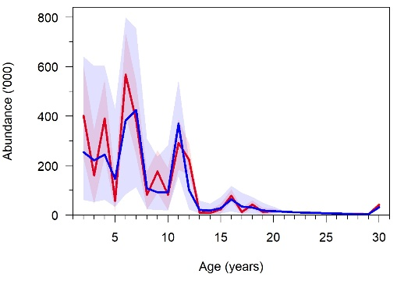
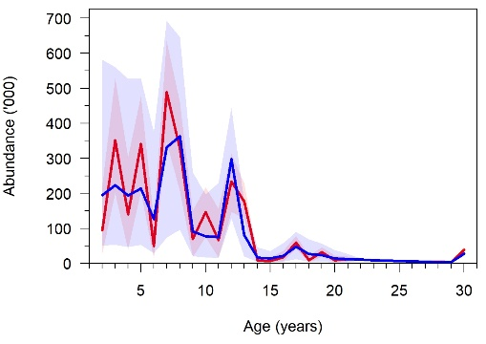
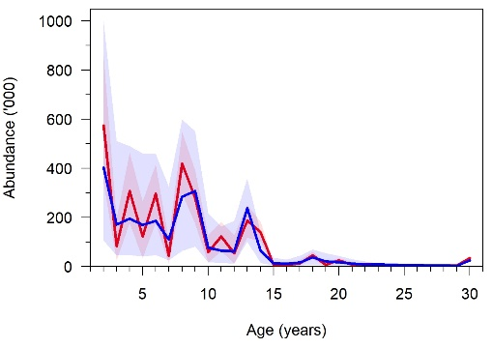
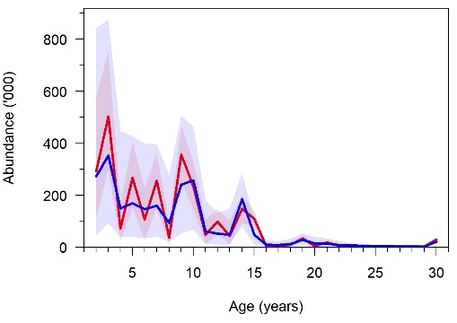
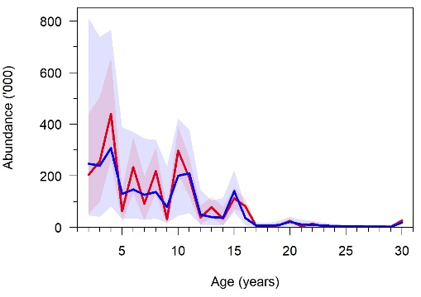
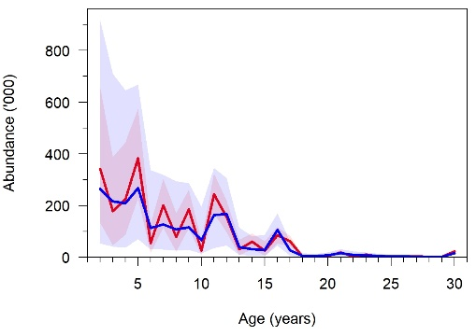
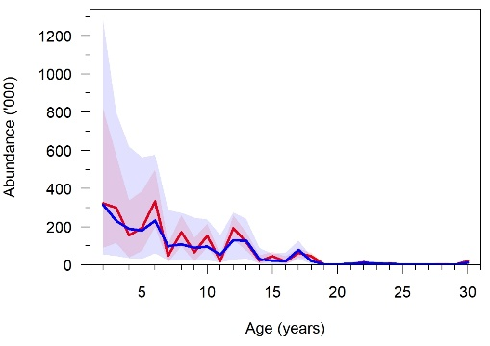
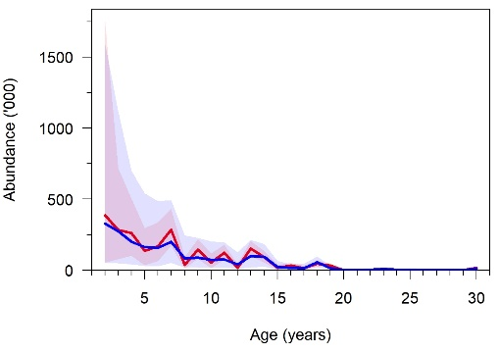
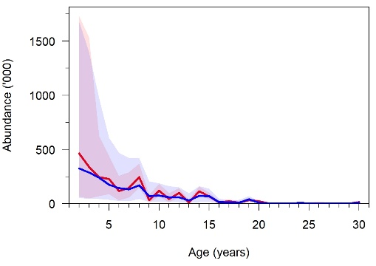
Results of Objective 1 (8 / 9)
Looking at MCMC results, we can note more variability in age structure for the younger ages (< 15-year-old) in the four-area model …
… but more uncertainty in the estimated age structure in the one-area model
2013
2014
2015
2016
2017
2018
2019
2020
2021

Slide 17
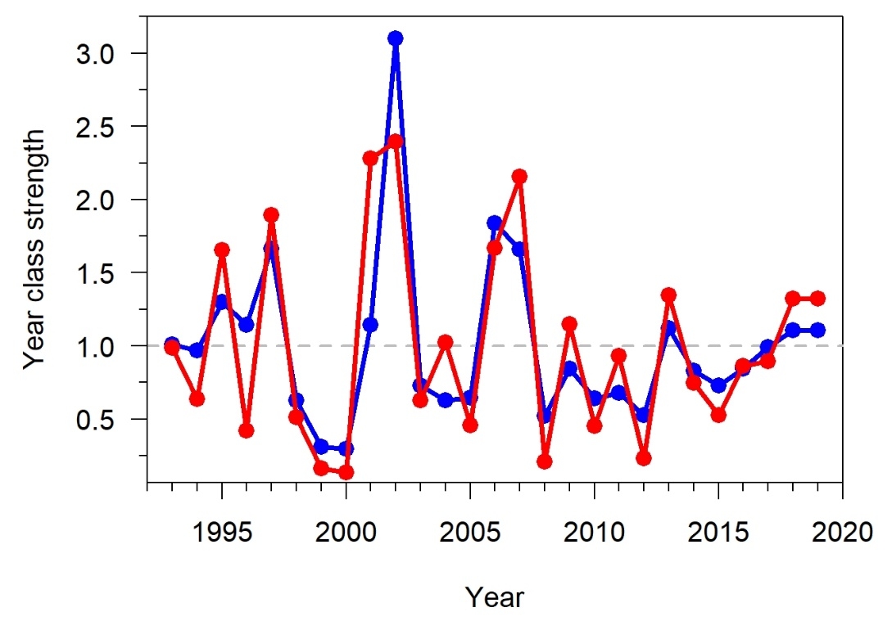
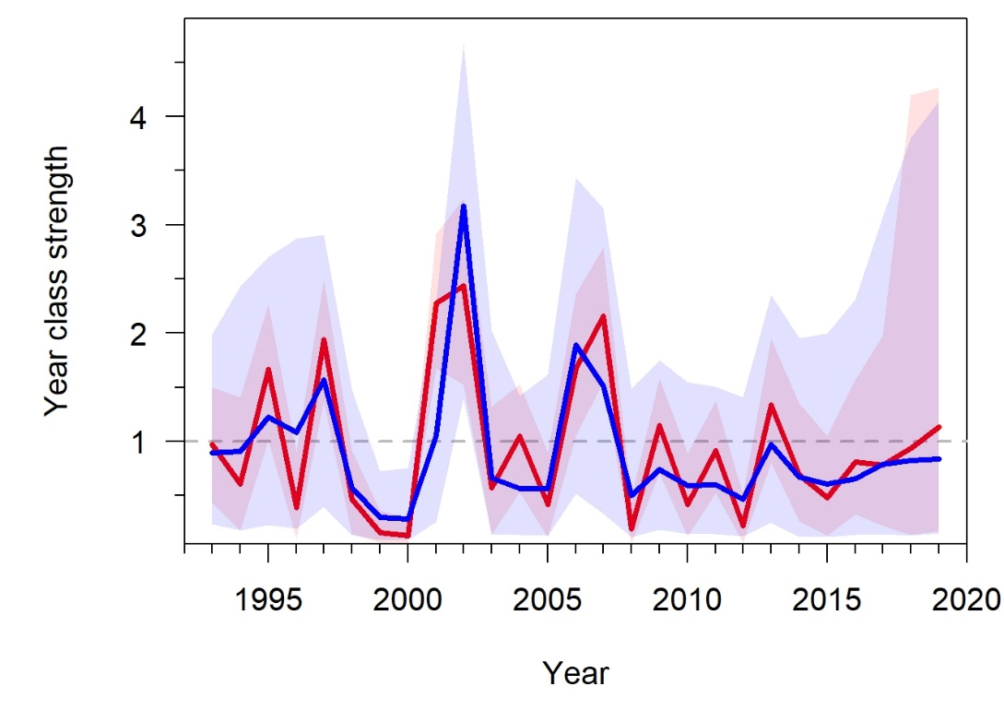
Results of Objective 1 (9 / 9)
Age structure results can be explained by looking at YCS results
Estimated YCS’s have more interannual variability but are less uncertain for the four-area model compared to the one-area model
MPD results
MCMC results

Slide 18
Results of Objective 2 (1 / 6)
Workshop Objective 2 addressed with the 100 replicates
Diagnostics and analyses conducted for Objective 1 also conducted for Objective 2
However, only MPD runs for Objective 2 - MCMC runs for the four-area model developed for Objective 1 took around 14 hours, and MCMC runs for the one-area model developed for Objective 1 took many hours
Analyses conducted over the 100 replicates:
(1) We compared the following predictions of the one-area and four-area models: SSB, stock status (SSB / B0), fishing pressure, age structure in select years (2014, 2017 and 2021) and YCS
(2) We also produced boxplots of B0, B2021, stock status (B2021 / B0) and R0 to compare the one-area and four-area models
Among all those quantities, R0 is the only quantity that is provided as input in the OM, i.e., we are able to determine bias in the estimated R0 for the four-area vs. the one-area model

Slide 19
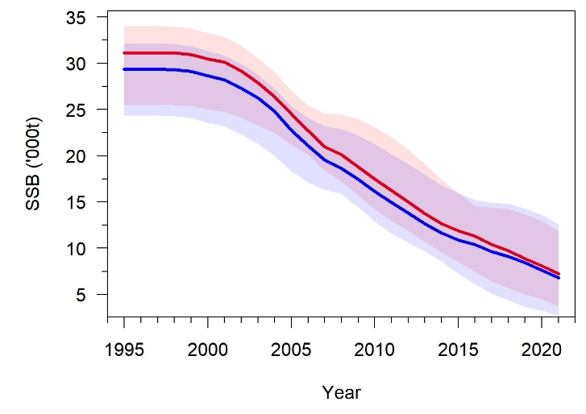
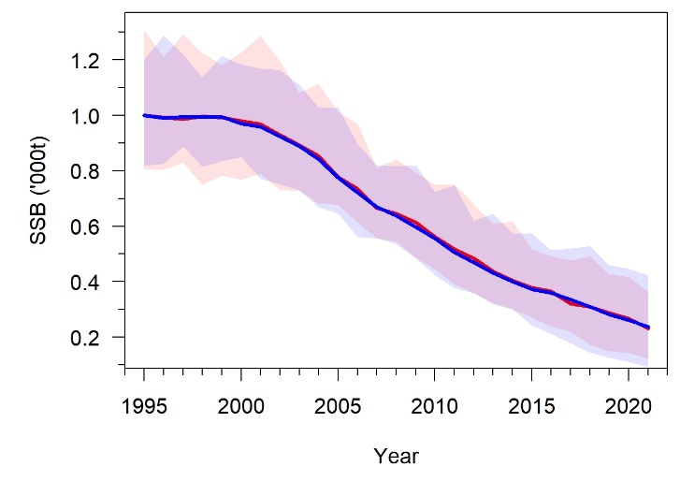
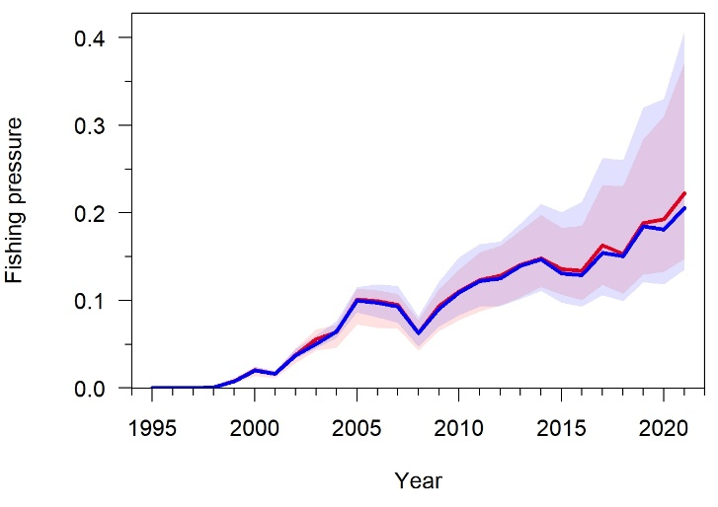
Results of Objective 2 (2 / 6)
SSBs are higher for the four-area model than for the one-area model
Median fishing pressures (over the 100 replicates) tend to be very slightly higher for the four-area model than for the one-area model

Slide 20
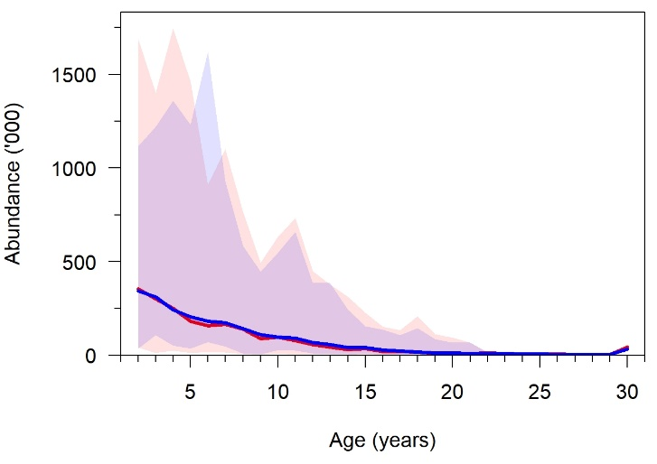
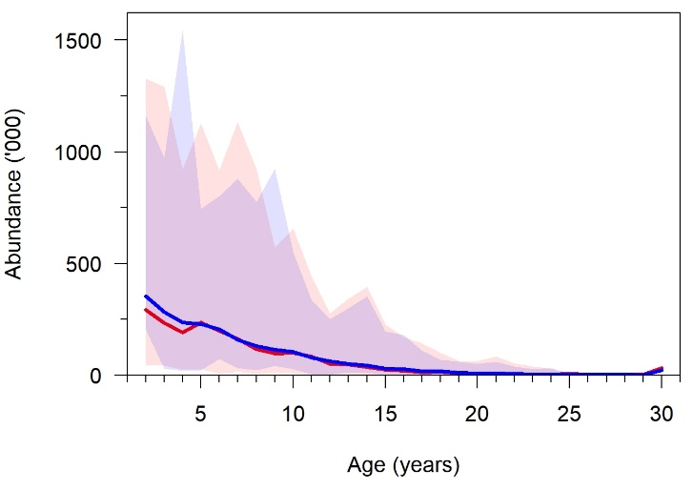
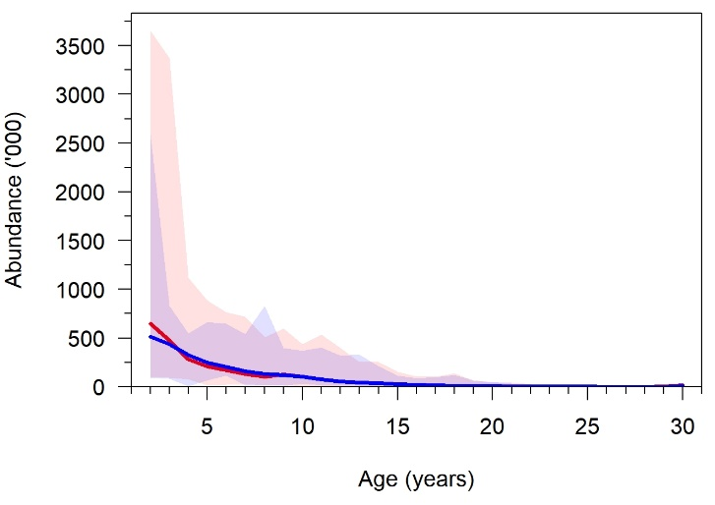
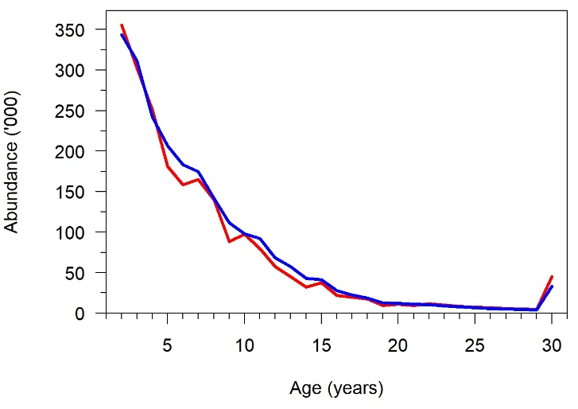
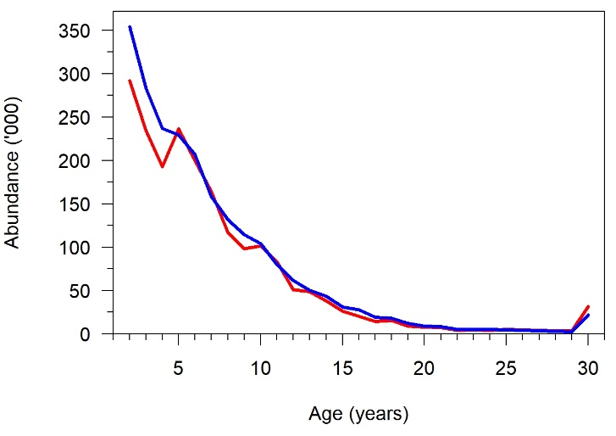
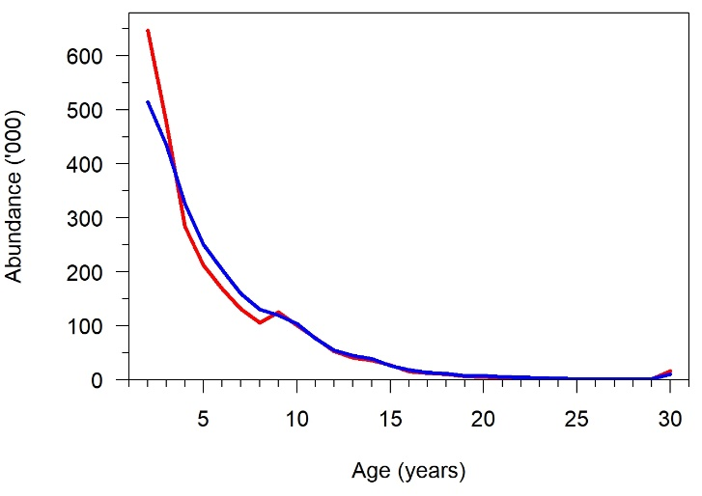
Results of Objective 2 (3 / 6)
There are differences in the abundances-at-age estimated by the four-area and the one-area models, especially more variability in age structure for the younger ages (< 15-year-old) in the four-area model
2014
2017
2021
Median value over all replicates plus ranges of values
Median value over all replicates

Slide 21
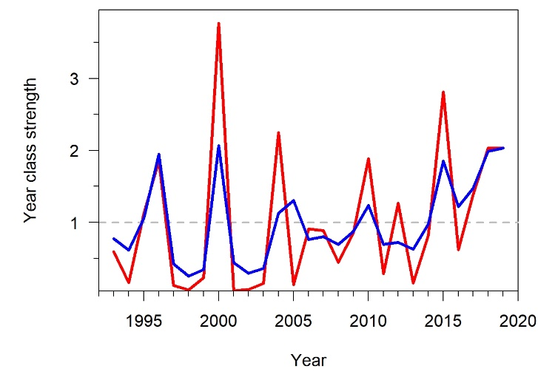
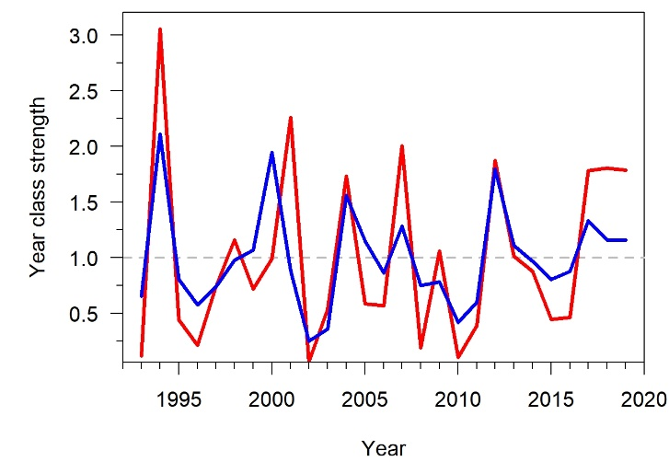
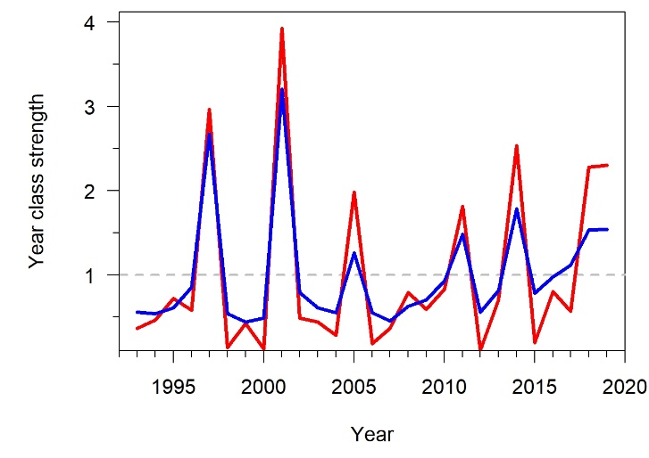
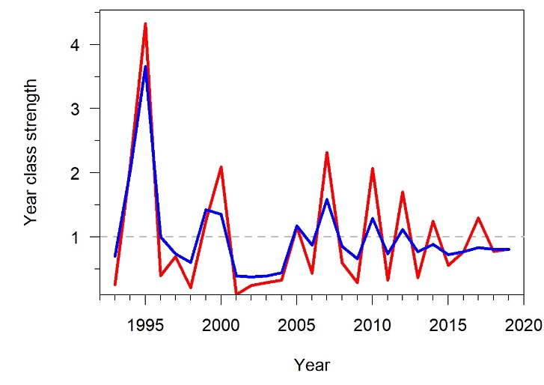
Results of Objective 2 (4 / 6)
Age structure results can be explained by looking at YCS results
Looking at individual replicates, estimated YCS’s have more interannual variability with the four-area model compared to the one-area model – 4 examples here:

Slide 22
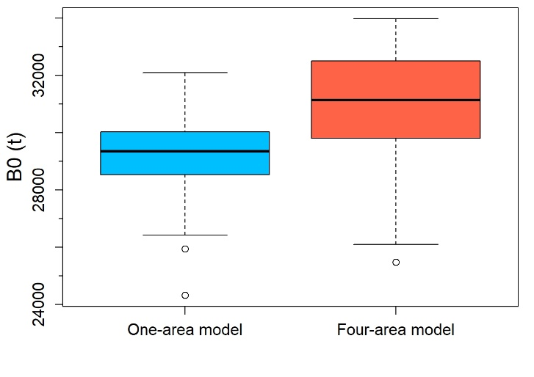
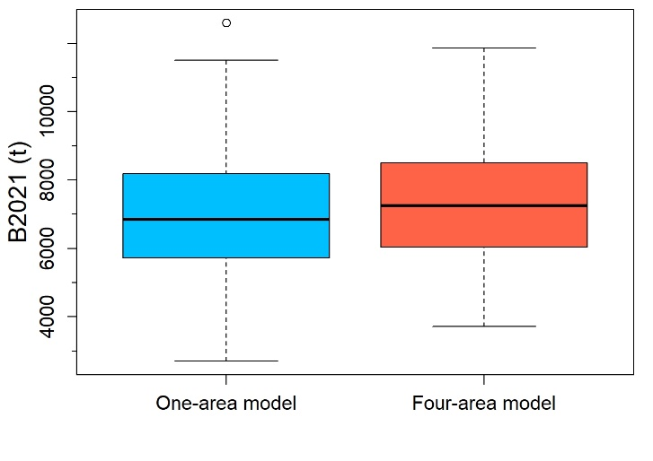

Results of Objective 2 (5 / 6)
Initial SSB (B0) higher for the four-area model than for the one-area model
Current SSB (B2021) very slightly higher for the four-area model than for the one-area model
Current status (B2021 / B0) similar for the four-area model and the one-area model

Slide 23


Results of Objective 2 (6 / 6)
The estimated initial recruitment (R0) is higher in the four-area model than in the one-area model
Contrary to other quantities (B0, B2021), R0 is estimated by the CASAL stock assessment models, but provided as input in the OM (R0 = 1 021 124; https://aaronmberger-nwfsc.github.io/Spatial-Assessment-Modeling-Workshop/articles/OM_Description_TOA.html), so bias in R0 can be calculated
The R0 estimated by all stock assessment models (one-area and four-area) is biased low by more than 40% (considering the 100 replicates)
The negative bias is significantly lower for the four-area model than for the one-area model

Slide 24
Conclusions (1 / 2)
Compared with the one-area model, the four-area model:
Predicts slightly higher SSBs, B0, B2021 and annual fishing pressures
But predicts a similar current stock status
Allows for the estimation of several selectivity-at-age functions that account for the ontogenetic migration patterns in TOA
Estimates YCS’s that have more interannual variability and are less uncertain
As a result predicts more variability in age structure for the younger ages (< 15-year-old) and a less uncertain age structure
Slightly reduces bias and error in the estimated R0

Slide 25
Conclusions (2 / 2)
Avenues for future research:
Our four-area model is not “complex”. It only accounts for some of the spatial structure in the study system with our use of the areas-as-fleets approach, yet we found out by comparing the unfished recruitment from the OM to the unfished recruitment from our models that the R0 in our models is biased low by more than 40%
Complexity that was missing in our models was the explicit representation of space with a true spatial model that would allow us to account for the fact that there is no complete mixing of tagged and untagged fish over space and would, therefore, allow us to estimate more accurate stock sizes for TOA
→ Using Casal2 (Doonan et al., 2016) (to be used for the actual TOA assessment in 2023) to attempt to develop a more spatially-explicit assessment model with migrations between regions
Improving the OM (Spatial Population Model), to later estimate biases in stock size for TOA to inform management and improve the spatial assessment model – particularly introducing the Ross Sea Shelf Survey in the OM, so that the survey catch-at-age data provided by the OM can be used to estimate YCS’s with the stock assessment model
The length of MCMC runs with CASAL deterred us from running MCMCs for Workshop Objective 2
→ Trying to implement more efficient MCMC algorithms in CASAL (e.g., The No U-Turn sampler; Monnahan et al., 2020)

